Slide 1
Virtualización y Cloud Computing
Serges Nanfack
Technical Manager
snanfack@cisco.com

Slide 2
Agenda
¿Qué es Cloud Computing?
Servicios en Cloud
Modelos de Cloud
Cloud Computing VS Data Centre
Virtualización de Servidores
Ventajas e Inconvenientes del Cloud Computing

Slide 3
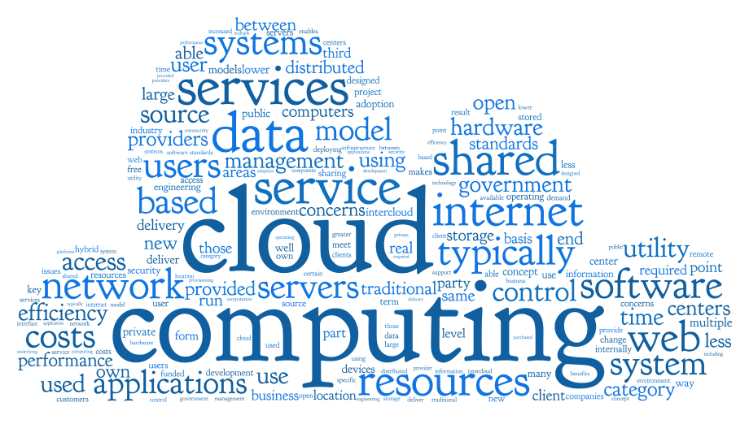
Notes:
To meet ever changing business needs organizations have to scale their IT infrastructure, they need time , money and specialized skills, new hardware and software.
That scaling process is usually slow and IT resources not used at their optimal level.
Also business are running different applications and offering services which are highly dependent of the IT infrastructure, for that they need a data centers, with office space, power , servers, cooling system , bandwidth, Network, a complicated software stack , bunch of programmers and experts. They also need production, testing , staging , failover environment.
And where there is problem you contact support , they don’t know and they blame someone else.
And when there is new version of software that come out you will need to upgrade and that might bring your whole system down and this is for one app or service , imagine your multiply this for dozen and more apps , it become very challenging, reason you see sometimes organizations struggling with their IT capacity.
Cloud computing is the solution : instead of running your applications yourself you run them through a shared server farm sitting in the Internet
It is like Microsoft exchange Vs Gmail , with Gmail do you need servers and Storage ? No ! , do you need a technical Team, to keep it up running ? No! do you need upgrades ? No . When you used any apps running in the cloud , you just login, customize it and start using it and enjoy the services .

Slide 4
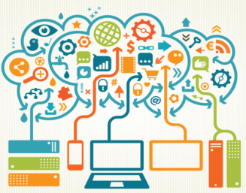
¿Qué es Cloud computing?
Cloud computing es un término paraguas para hacer referencia a desarrollos y servicios fundamentados en Internet
  Entornos Remotos: Los Servicios y los Datos se almacenan y gestionan en Infraestructuras Remotas.
  Ubiquidad: Los Servicios y Datos serán accesibles y estarán disponibles desde cualquier ubicación.
  Commodified: El resultado global es un modelo de Servidores y Servicios funcionando como un servicio público (utility) como si fuera un servicio de gas o electricidad en el que se paga por aquello que se quiere y consume
Notes:
In addition, the platform provides on demand services, that are always on, anywhere, anytime and any place.
Pay for use and as needed, elastic
scale up and down in capacity and functionalities
The hardware and software services are available to
general public, enterprises, corporations and businesses markets

Slide 5





El Ritmo de los Cambios se Accelera
En 2017, 90% de los usuarios de internet accederán a través de dispositivos móviles
En 2014, 74% de las empresas tendrán una estrategia de Cloud híbrida
En 2020 tendremos 50B de dispositivos autónomos interconectados
En 2015 180B aplicaciones móviles se descargarán
De 2012 a 2020 la cantidad de datos se duplicará cada dos años
Mobile
Cloud
IoT
Apps
Big Data &
Analytics
Notes:
More businesses and organizations are seeking technology solutions to solve their important challenges.
And as more people, processes, data and things become connected, the pace of change is accelerating.
These network-centric trends are creating challenges and opportunities for customers and for Cisco.
Consider:
99.4% of the physical world is unconnected
We expect 21 billion devices on the Internet by 2018 (50B by 2020)
180 billion apps will be downloaded in 2015
IoE Value at Stake is estimated at $19T over the next 10 years
Wi-Fi (49%) and mobile-connected devices (12%) will generate 61 percent of IP traffic by 2018
IP video will be 79 percent of all IP traffic by 2018
Global IP traffic is expected to reach 132 exabytes per month by 2018, which is the equivalent to:
8.8 billion screens streaming the FIFA World Cup final game in Ultra-HD/4K at the same time;
5.5 billion people binge-watching "Game of Thrones" Season 4 via video-on-demand in HD or 1.5 billion watching in Ultra-HD/4K;
4.5 trillion YouTube clips; and
940 quadrillion text messages
Sources: Cisco's Visual Networking Index Forecast 2014 / Gartner / Cisco IoE

Slide 6
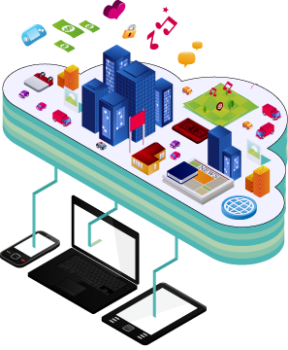
Servicios Cloud
Los Servicios Cloud son fáciles de identificar. Pues…
No se instalan en su infraestructura. Suele conectarse a ellos a través de un navegador Web.
Los datos están junto al Servicio (no en su computador): no hay que preocuparse de las copias de seguridad, de garantizar que no los perdemos, ni de copiarlos cuando cambiamos de un ordenador a otro: el Servicio Cloud se encarga de todo por nosotros.
Son accesibles desde cualquier dispositivo siempre y cuando tengamos un Navegador Web (sea un laptop, un Smartphone, una Tablet) con lo que los Servicios son fácilmente disponibles en movilidad.
Notes:
Computer used to work alone inside a house or an office , but now with the power of internet , we can use the power of a computing system at the different location

Slide 7
Servicios Cloud
Tipo | Descripción
Software as a Service (SaaS) | El proveedor Cloud se encarga del acceso a los Servicios, como podrían ser email, soluciones de Comunicación y Office 365 que se suministran a través de Internet. El usuario es el encargado de poner sus propios datos.
Platform as a Service (PaaS) | El proveedor Cloud es responsable del acceso a las herramientas de desarrollo y de los servicios usados para entregar las aplicaciones.
Infrastructure as a Service (IaaS) | El proveedor Cloud es responsable del acceso a los equipos de red, a los servicios de red virtualizados y de la infraestructura de red utilizada.
Notes:
IaaS delivers computer infrastructure, typically a platform virtualization environment, as a service. Rather than purchasing servers, software, data center space or network equipment, clients instead buy those resources as a fully outsourced service.
PaaS deliver a computing platform where the developers can develop their own applications.
SaaS is a model of software deployment where the software applications are provided to the customers as a service.

Slide 8
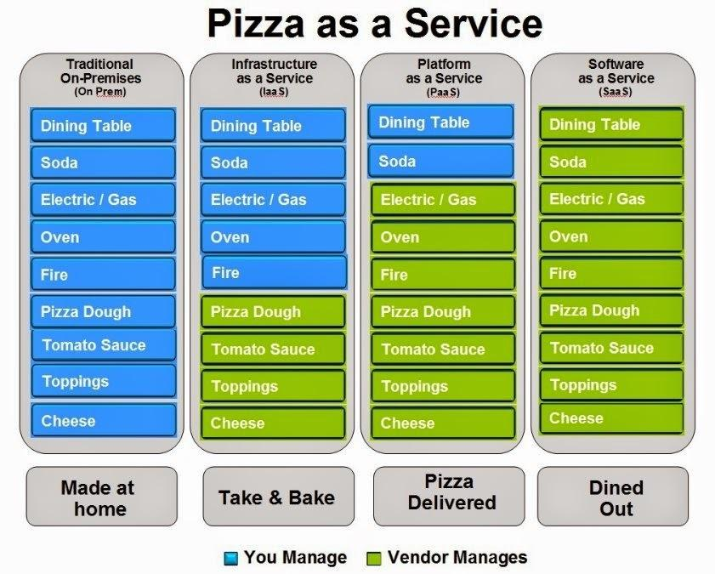
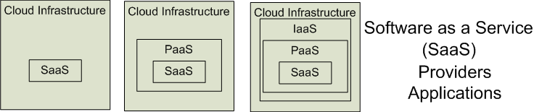

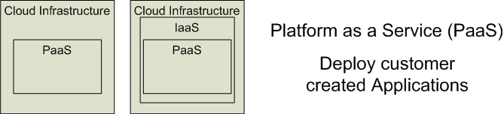

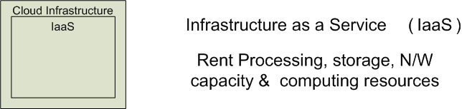

Software as a Service (SaaS)
Platform as a Service (PaaS)
Google App Engine
Infrastructure as a Service (IaaS)

Slide 9
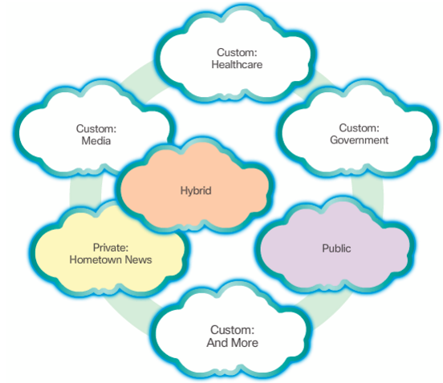
Modelos Cloud
  Clouds Privados
  Clouds Públicos
  Clouds Híbridos
  Clouds A Medida/verticales
Notes:
Private clouds: Cloud-based applications and services offered in a private cloud are intended for a specific organization or entity, such as the government. A private cloud can be set up using the organization’s private network, though this can be expensive to build and maintain. A private cloud can also be managed by an outside organization with strict access security. The Private cloud is highly secured.
Public clouds: Cloud-based applications and services offered in a public cloud are made available to the general population. Services may be free or are offered on a pay-per-use model, such as paying for online storage. The public cloud uses the Internet to provide services. It is offered by a cloud services provider and offers the highest level of efficiency and scalability.
Hybrid clouds: A hybrid cloud is made up of two or more clouds (example: part custom, part public), where each part remains a distinctive object, but both are connected using a single architecture. Individuals on a hybrid cloud would be able to have degrees of access to various services based on user access rights. In the Hybrid clouds , some services and applications are run on the private cloud network while others are run on the public cloud.
Custom clouds: These are clouds built to meet the needs of a specific industry, such as healthcare or media. Custom clouds can be private or public

Slide 10
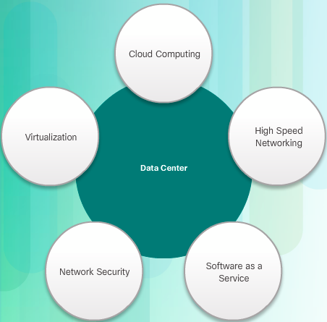
Cloud Computing VS Data Centre
Data center: Típicamente un entorno de almacenamiento de datos e infraestructuras de procesamiento que se ejecutan en las instalaciones de un departamento de IT o se alquilan fuera de nuestras instalaciones.
Cloud computing: Típicamente un servicio mantenido fuera de nuestras instalaciones que nos da acceso bajo demanda a un conjunto de recursos de computador configurable. Dichos recursos pueden proveerse o devolverse de forma muy rápida, en función de nuestras necesidades.
Notes:
Cloud computing is possible because of data centers.
A data center is a facility used to house computer systems and associated component
A data center can occupy one room of a building, one or more floors, or an entire building. Data centers are typically very expensive to build and maintain. For this reason, only large organizations use privately built data centers to house their data and provide services to users. Smaller organizations that cannot afford to maintain their own private data center can reduce the overall cost of ownership by leasing server and storage services from a larger data center organization in the Cloud.
Cloud computing is often a service provided by data centers

Slide 11
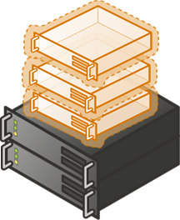
Virtualización de Servidor
La VIRTUALIZACIÓN es la base del Cloud computing.
El CLOUD COMPUTING separa las aplicaciones del hardware.
La VIRTUALIZACIÓN separa el Sistema Operativo del hardware.
Notes:
The terms “Cloud computing” and “virtualization” are often used interchangeably; however, they mean different things.
Without it, Cloud computing, as it is most-widely implemented, would not be possible.

Slide 12
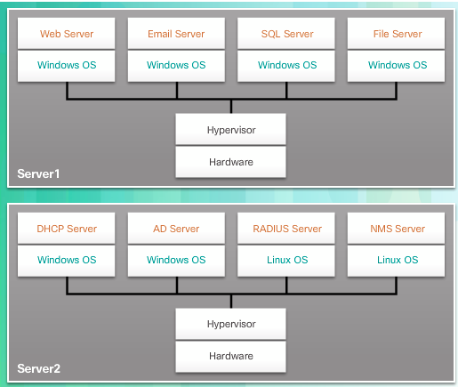
Virtualización de Servidor
La Virtualización de Servidor se aprovecha de recursos que no se están utilizando pero están disponibles, y permite la consolidación del número de servidores necesarios en global.
El Hipervisor es un programa, un firmware o un hardware que añade una capa de abstracción por encima del hardware físico real.
El uso de soluciones de virtualización normalmente incluye aspectos de redundancia para estar preparados ante un único punto de fallo
Notes:
The abstraction layer is used to create virtual machines which have access to all the hardware of the physical machine such as CPUs, memory, disk controllers, and NICs.

Slide 13
Ventajas e Inconvenientes del Cloud Computing
VENTAJAS | INCONVENIENTES
Rendimiento Mejorado: Los ordenadores en un sistema de Cloud Computing arrancan y funcionan más rápido debido a que tienen menos programas y procesos cargados en memoria… | Requieren una conexión permanente a Internet: Las soluciones de Cloud Computing no serán posible si no existe la posibilidad de conexión a Internet
Coste de Software Reducido: En lugar de comprar costosas aplicaciones software, podrá acceder a lo que necesite a través de subscripciones por uso tipo free-ish! | No funciona bien en entornos de conexión a Internet de bajo ancho de banda: Las aplicaciones basadas en Web requieren de un gran ancho de banda para funcionar y poder descargar grandes cantidades de información (documentos)
Reducción del Coste de Computador: Ya no son necesarios potentes y caros computadores para ejecutar las aplicaciones basadas en Web de los entornos de Cloud Computing | Funcionalidades limitadas: Suele poder hacerse más y mejor con aplicaciones locales como Microsoft PowerPoint que con soluciones Cloud como Google Presentation
Actualizaciones Instantáneas de Software y Redundancia y Disponibilidad de Datos | No podemos securizar ni garantizar la no pérdida de datos. Debemos confiar en nuestro proveedor
Notes:
Cloud computing is impossible if you cannot connect to the Internet.
Since you use the Internet to connect to both your applications and documents, if you do not have an Internet connection you cannot access anything, even your own documents.
A dead Internet connection means no work and in areas where Internet connections are few or inherently unreliable, this could be a deal-breaker.
Stored data might not be secure:
With cloud computing, all your data is stored on the cloud.
The questions is How secure is the cloud?
Can unauthorised users gain access to your confidential data?
Stored data can be lost:
Theoretically, data stored in the cloud is safe, replicated across multiple machines.
But on the off chance that your data goes missing, you have no physical or local backup.
Put simply, relying on the cloud puts you at risk if the cloud lets you down.

